Slide 1
FILE TRANSFER PROTOCOL RFC 959

Slide 2
What is FTP
File Transfer Protocol (FTP) is a standard Internet protocol for transmitting files between computers on the Internet over TCP/IP connections.
FTP is a client-server protocol where a client will ask for a file, and a local or remote server will provide it.
It is is an application layer protocol which moves files between local and remote file systems.

Slide 3
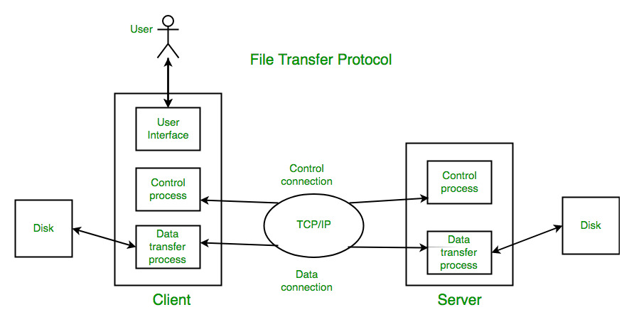
The FTP model

Slide 4
FTP model
The FTP client has three components: the user interface, control process, and data transfer process.
The server has two components: the server control process and the server data transfer process.

Slide 5
Connections in FTP
There are two types of connections in FTP:
Control Connection: The control connection uses very simple rules for communication. Through control connection, we can transfer a line of command or line of response at a time. The control connection is made between the control processes. The control connection remains connected during the entire interactive FTP session.
Data Connection: The Data Connection uses very complex rules as data types may vary. The data connection is made between data transfer processes. The data connection opens when a command comes for transferring the files and closes when the file is transferred.

Slide 6
FTP model
Both the client and server have two processes allowing these two types of information to be managed:
• DTP (Data Transfer Process) It establishes the connection and managing the data channel. The server side DTP is called SERVER-DTP, the client side DTP is called USER-DTP
• PI (Protocol Interpreter) Controls DTP using commands received over the control channel. It is different on the client and the server.

Slide 7
FTP model
The SERVER-PI is responsible for listening to the commands coming from a USER-PI over the control, establishing the connection for the control channel, receiving FTP commands from the USER-PI over this, responding to them and running the SERVER-DTP.
The USER-PI is responsible for establishing the connection with the FTP server, sending FTP commands, receiving responses from the SERVER-PI and controlling the USER-DTP if needed.

Slide 8
FTP model
When an FTP client is connected to a FTP server, the USER-PI initiates the connection to the server according to the Telnet protocol.
The client sends FTP commands to the server, the server interprets them, runs its DTP, then sends a standard response.
Once the connection is established, the server-PI gives the port on which data will be sent to the Client DTP.
The client DTP then listens on the specified port for data coming from the server.

Slide 9
It is important to note that since the control and data ports are separate channels, it is possible to send commands from one machine and receive data on another. So, for example it is possible to transfer data between FTP servers by passing through a client to send control instructions and by transferring information between two server processes connected on the right port.

Slide 10
Data Structures
File Transfer Protocol allows the structure of a file to be specified. Three structures are defined in FTP:
File Structure.
Record Structure.
Page Structure.
File Structure: The file structure format is used by default when the structure command has not been used. It is a continuous stream of data bytes.

Slide 11
Data Structures
Record Structure: Record structures must be accepted for "text" files (i.e., files with TYPE ASCII or EBCDIC) by all FTP implementations. In record-structure the file is made up of sequential records.
Page Structure: In the page structure, the file is divided into pages, with each page having a page number and a page header. The pages can be stored and accessed randomly or sequentially.

Slide 12
Data Types
Data representations are handled in FTP by a user specifying a representation type. There are four different data types specified in the FTP standard:
ASCII ( American Standard Code for Information Interchange )
EBCDIC ( Extended Binary Coded Decimal Interchange Code )
Image
Local

Slide 13
ASCII
This is the default type and must be accepted by all FTP implementations.
It is intended primarily for the transfer of text files, except when both hosts would find the EBCDIC type more convenient.
The sender converts the data from an internal character representation to the standard 8-bit NVT-ASCII representation. ( NVT - Network Virtual Terminal)
The receiver will convert the data from the standard form to his own internal form.

Slide 14
EBCDIC
This type is intended for efficient transfer between hosts which use EBCDIC for their internal character representation.
For transmission, the data are represented as 8-bit EBCDIC characters.
The character code is the only difference between the functional specifications of EBCDIC and ASCII types.

Slide 15
Image
The data are sent as contiguous bits which, for transfer, are packed into the 8-bit transfer bytes.
The receiving site must store the data as contiguous bits.
Image type is intended for the efficient storage and retrieval of files and for the transfer of binary data.
It is recommended that this type be accepted by all FTP implementations.

Slide 16
Local Type
The data is transferred in logical bytes of the size specified by the obligatory second parameter, Byte size.
The value of Byte size must be a decimal integer; there is no default value.
The logical byte size is not necessarily the same as the transfer byte size.
If there is a difference in byte sizes, then the logical bytes should be packed contiguously, disregarding transfer byte boundaries and with any necessary padding at the end.

Slide 17
Local Type
When the data reaches the receiving host, it will be transformed in a manner dependent on the logical byte size and the particular host.
This transformation must be invertible (i.e., an identical file can be retrieved if the same parameters are used) and should be well publicized by the FTP implementors.

Slide 18
Transmission Mode
FTP can transfer a file across the data connection using one of the following three transmission modes:
Stream Mode.
Block Mode.
Compressed Mode.
All data transfers must be completed with an end-of-file (EOF) which may be explicitly stated or implied by the closing of the data connection.

Slide 19
The stream mode is the default mode; data are delivered from FTP to TCP as a continuous stream of bytes.
In the block mode, data can be delivered from FTP to TCP in blocks. In this case, each block is preceded by a 3-byte header.
The first byte is called the block descriptor; the next two bytes define the size of the block in bytes.
In the compressed mode data is compressed using a simple algorithm and is then sent to the TCP.

Slide 20
Security
The FTP protocol was designed when security was not a big issue.
Although FTP requires a password, the password is sent in plaintext (unencrypted), which means it can be intercepted and used by an attacker.
To be secure:
We can add a Secure Socket Layer between the FTP application layer and the TCP layer. In this case FTP is called SSL-FTP.
We can use a secure tunnel such as Secure Shell (SSH) or virtual private network (VPN).
We can use a different, more secure protocol that can handle the job, e.g. SSH File Transfer Protocol or Secure Copy Protocol.

Slide 21
Trivial File Transfer Protocol (TFTP)
It is good for simple file transfers, such as during boot time.
It uses User Datagram Protocol(UDP) as transport layer protocols. Errors in the transmission (lost packets, checksum errors) must be handled by the TFTP server.
It uses only one connection through well known port 69.
TFTP uses a simple lock-step protocol (each data packet needs to be acknowledged). Thus the throughput is limited.

Slide 22
Secure File Transfer Protocol (SFTP)
SFTP can also be called as SSH(Secure Shell) File Transfer Protocol.
Unlike FTP or TFTP, SFTP is secure and requires authentication over SSH.
In addition to the commands sent, data is also encrypted whilst in transit, which makes this option the most preferred over TFTP and FTP.
SFTP runs using TCP on Port 22 by default.

Slide 23
FTP COMMANDS
There are three different types of FTP commands:
• Access control commands
• Transfer parameter commands
• FTP service commands

Slide 24
ACCESS CONTROL COMMANDS
• USER: Character string allowing the user to be identified. User identification is necessary to establish communication over the data channel.
• PASS: Character string specifying the user's password. This command must immediately precede the USER command. It falls to the client to hide the display of this command for security reasons.
• ACCT: Character string representing the user's account. The command is generally not necessary. During the response accepting the password, if the response is 230 this stage is not necessary, if the response is 332, it is.

Slide 25
• CWD: Change Working Directory: This command enables the current directory to be changed. This command requires the directory's access path to be fulfilled as an argument.
• CDUP: Change to Parent Directory: This command allows you to go back to the parent directory. It was introduced to solve problems of naming the parent directory according to the system (generally “..”).
• SMNT: Structure Mount
• REIN: Reinitialize
• QUIT: Command enabling the current session to be terminated. The server waits to finish the transfer in progress if the need arises, then supplies a response before closing the connection.

Slide 26
TRANSFER PARAMETER COMMANDS
• PORT: Character string allowing the port number used to be specified.
• PASV: Command making it possible to indicate to the DTP server to stand by for a connection on a specific port chosen randomly from among the available ports. The response to this command is the IP address of the machine and port.
• TYPE: This command enables the type of format in which the data will be sent to be specified.

Slide 27
• STRU: Telnet character specifying the file structure (F for File, R for Record, P for Page).
• MODE: Telnet character specifying data transfer method (S for Stream, B for Block, C for Compressed)

Slide 28
FTP SERVICE COMMANDS
• RETR: This command (RETRIEVE) asks the server DTP for a copy of the file whose access path is given in the parameters.
• STOR: This command (store) asks the server DTP to accept the data sent over the data channel and store them in a file bearing the name given in the parameters. If the file does not exist, the server creates it, if not it overwrites it.
• STOU: This command is identical to the previous one, only it asks the sever to create a file where the name is unique. The name of the file is returned in the response.

Slide 29
• APPE: (append) the data sent is concatenated into the file bearing the name given in the parameter if it already exists, if not, it is created.
• ALLO: This command (allocate) asks the server to plan a storage space big enough to hold the file whose name is given in the argument.
• REST: This command (restart) enables a transfer to be restarted from where it stopped. To do so, the command sends the marker representing the position in the file where the transfer had been interrupted in the parameter. This command must immediately follow a transfer command.
• RNFR: This command (rename from) enables a file to be renamed. In the parameters it indicates the name of the file to be renamed and must be immediately followed by the RNTO command.

Slide 30
• RNTO: This command (rename to) enables a file to be renamed. In the parameters it indicates the name of the file to be renamed and must be immediately followed by the RNFR command.
• ABOR: This command (abort) tells the server DTP to abandon all transfers associated with the previous command. If no data connection is open, the DTP sever does nothing, if not it closes it. The control channel however remains open.
• DELE: This command (delete) allows a file to be deleted, the name of which is given in the parameters. This command is irreversible, confirmation can only be given at client level.
• RMD: This command (remove directory) enables a directory to be deleted. The name of the directory to be deleted is indicated in the parameters.

Slide 31
• MKD: This command (make directory) causes a directory to be created. The name of the directory to be created is indicated in the parameters.
• PWD: This command (print working directory) makes it possible to resend the complete current directory path.
• LIST: This command allows the list of files and directories present in the current directory to be resent. This is sent over the passive DTP. It is possible to place a directory name in the parameter of this command, the server DTP will send the list of files in the directory placed in the parameter.
• NLST: This command (name list) enables the list of files and directories present in the current directory to be sent.

Slide 32
FTP Replies
Replies to File Transfer Protocol commands are devised to ensure the synchronization of requests and actions in the process of file transfer, and to guarantee that the user process always knows the state of the Server.
Every command must generate at least one reply, although there may be more than one
An FTP reply consists of a three digit number (transmitted as three alphanumeric characters) followed by some text. The number is intended for use by automata to determine what state to enter next.

Slide 33
Multiline reply
Format:
123-First line
Second line
234 A line beginning with numbers
123 The last line

Slide 34
There are five values for the first digit of the reply code
1yz Positive Preliminary reply
2yz Positive Completion reply
3yz Positive Intermediate reply
4yz Transient Negative Completion reply
5yz Permanent Negative Completion reply

Slide 35
Application of File Transfer Protocol
FTP finds application in many day-to-day business operations that span business-to-business and peer-to-peer data transfer use cases, including:
Organizations use FTP to allow employees to share files across different locations and branch offices.
Employees use FTP to securely share files with coworkers and external business partners.
IT teams use FTP to transfer data back to DR (disaster recovery) sites.
Webmaster teams use FTP to transfer Web pages, Web application files, and images to their Web server.

Slide 36
Thank You

